Slide 1



APNET ’26 · SINGAPORE · AUGUST 2026
Multi-CDN as a Collective Service:
Towards Hot Start in Congestion Control at Scale
Can a new CDN node start with what another node has already learned?
Probe once. Reuse safely across nodes.
Tong Li ♥︎♣ · Jiuxiang Zhu ♥︎◆ · Bo Wu ◆
Cheng Luo ◆ · Haoyi Fang ♥︎ · Xiaofei Yu ◆ · Ke Xu ♣
♥︎
◆
♣
Notes:
[English Speaker Notes]
Good afternoon. I’m xxx. Today I’ll present hStart, our work on hot-start congestion control for multi-CDN services. Our starting question is simple: when a client is scheduled to a new CDN node, can that node benefit from what another node has already learned? hStart treats multi-CDN infrastructure as a collective transport service: probe once, share selectively, and reuse the state safely across nodes.

Slide 2
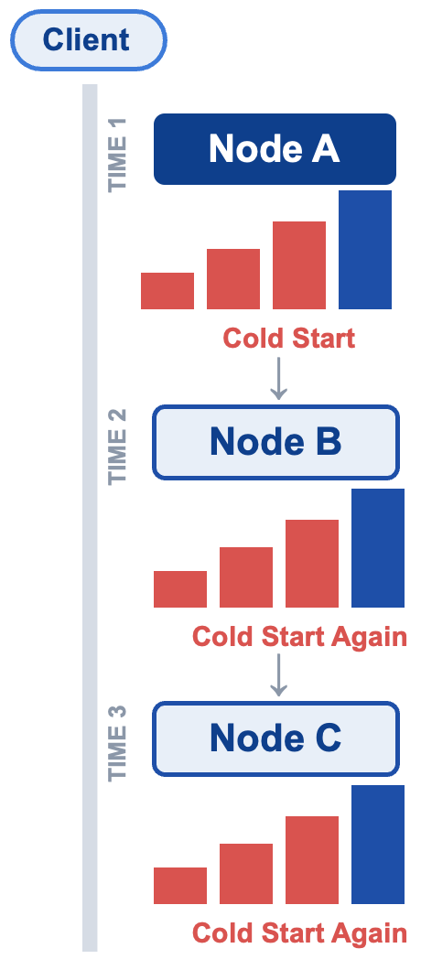
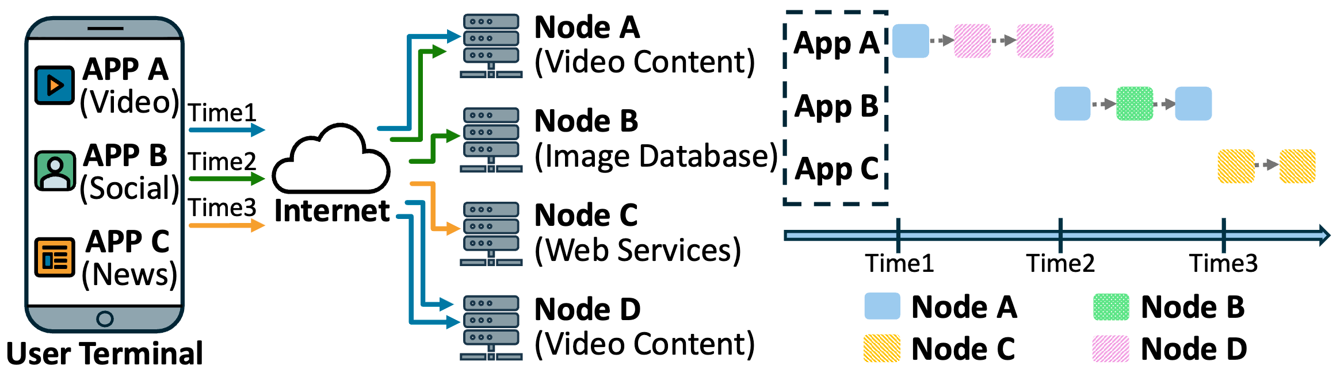
THE PROBLEM
You pay the cold-start tax — again and again
Cold Start Repeats Across CDN Nodes
01
02
3–4
The client may stay still.
Transport knowledge does not follow.
RTTs are wasted again.
Load balancing and application switching move requests across nodes.
Default QUIC repeatedly probes from a conservative initial window.
A new node cannot use the RTT, bandwidth, or cwnd already learned elsewhere.
Notes:
[English Speaker Notes]
In modern applications, the user may stay physically still, but load balancing and application switching continuously move requests across CDN nodes. On the left of the diagram, one terminal switches among video, social, and news applications, while the colored paths send its requests to Nodes A through D. The timeline in the middle shows that the serving node changes at Time 1, 2, and 3. The panel on the right highlights the consequence: every newly connected node starts again from a small congestion window, so the same rate increase appears as cold start, cold start, again, and again. Transport knowledge does not move with the request, and default QUIC therefore spends another three to four RTTs probing the path each time.

Slide 3
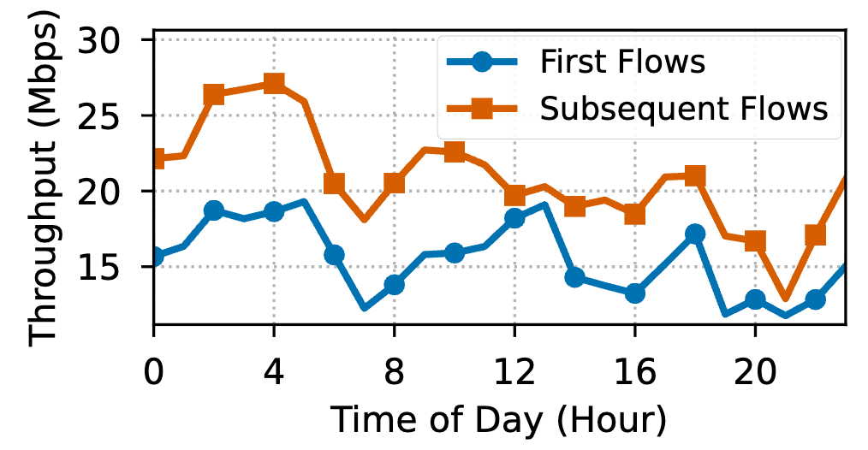
MEASUREMENT · REAL 2-WEEK CDN LOGS
First flows are both weak and dominant
74%
First-flow throughput relative to subsequent flows on the same connection.
38.8%
of video segments transmitted by the first flow
45%
of connections carry only one flow
Poor first-flow users stall ~3× more:
0.31% vs 0.11% (avg 0.13%).
Notes:
[English Speaker Notes]
We analyzed two weeks of real CDN logs from a popular video application. The first flow achieves only seventy-four percent of the throughput of subsequent flows on the same connection. This matters because 38.8 (thirty-eight point eight) percent of video segments are transmitted by the first flow, and 45 (forty-five) percent of connections carry only one flow. The QoE impact is also visible: users with poor first-flow performance have a stall rate of 0.31 (zero point three one) percent, versus 0.11 (zero point one one) percent for users with good first-flow performance.

Slide 4
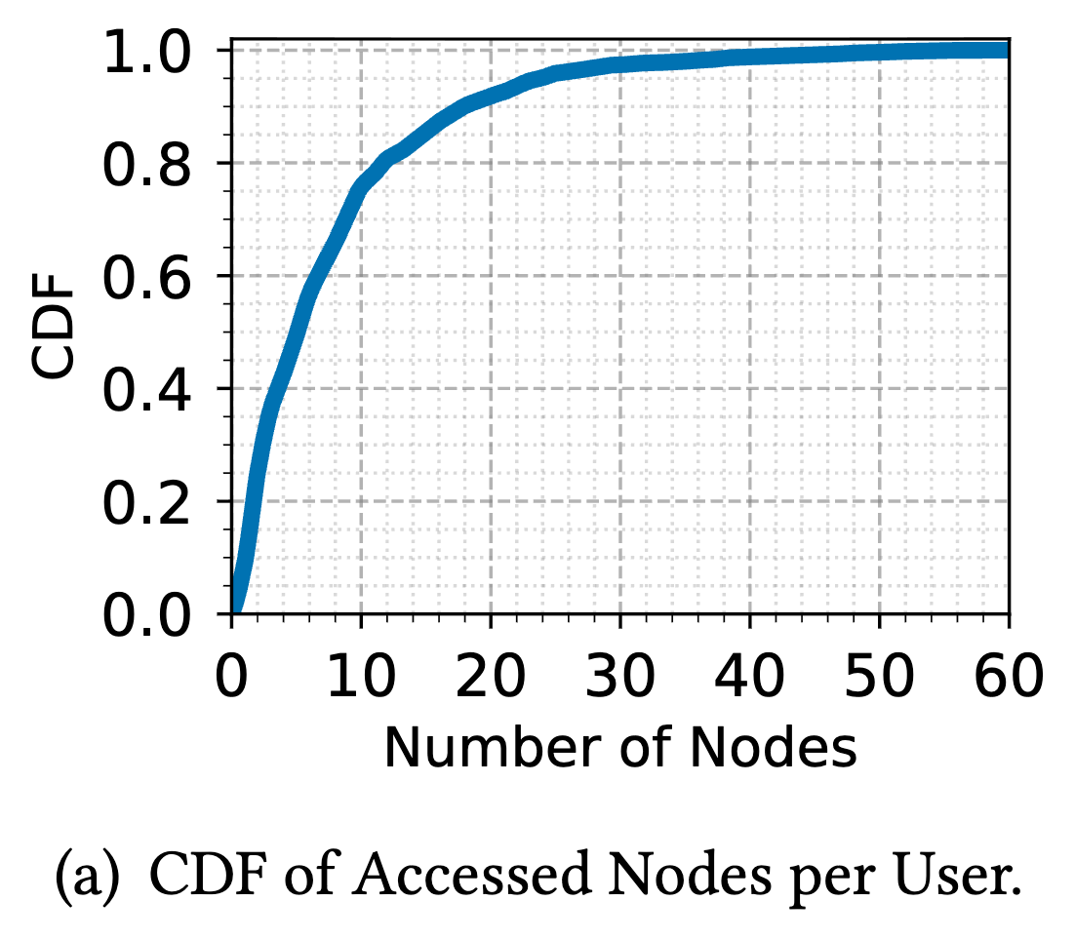
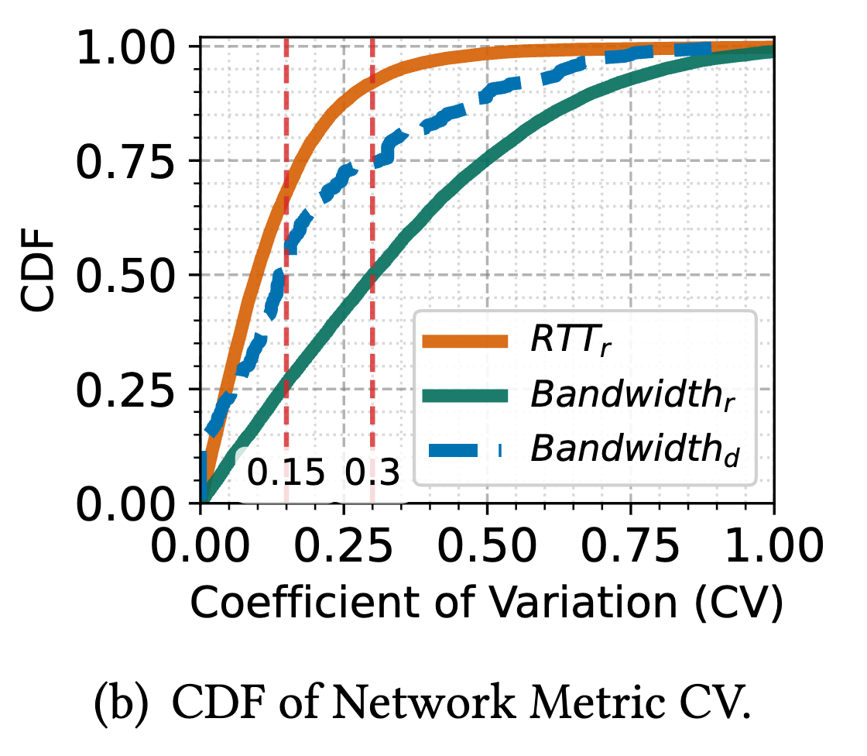
MEASUREMENT · ACCESS BEHAVIOR
Cross-Node Reuse Is Necessary—and Often Possible
Cross-node access is frequent.
Access-side network quality is often correlated.
≈75%
75%
of users access at least two geographically distinct CDN nodes.
of dial-test agents have cross-node bandwidth CV below 0.3.
~50% of production users also show bandwidth CV < 0.3 across nodes.
Notes:
[English Speaker Notes]
Cross-node state reuse is necessary because about seventy-five percent of users access at least two geographically distinct CDN nodes. It is also possible for many users because the paths often share the same access-side bottleneck. In our dial-test data, seventy-five percent of agents have a cross-node bandwidth coefficient of variation below 0.3 (zero point three). In production data, roughly half of users show the same level of bandwidth stability. This is not universal, but it creates a strong opportunity for safe, confidence-aware reuse.

Slide 5
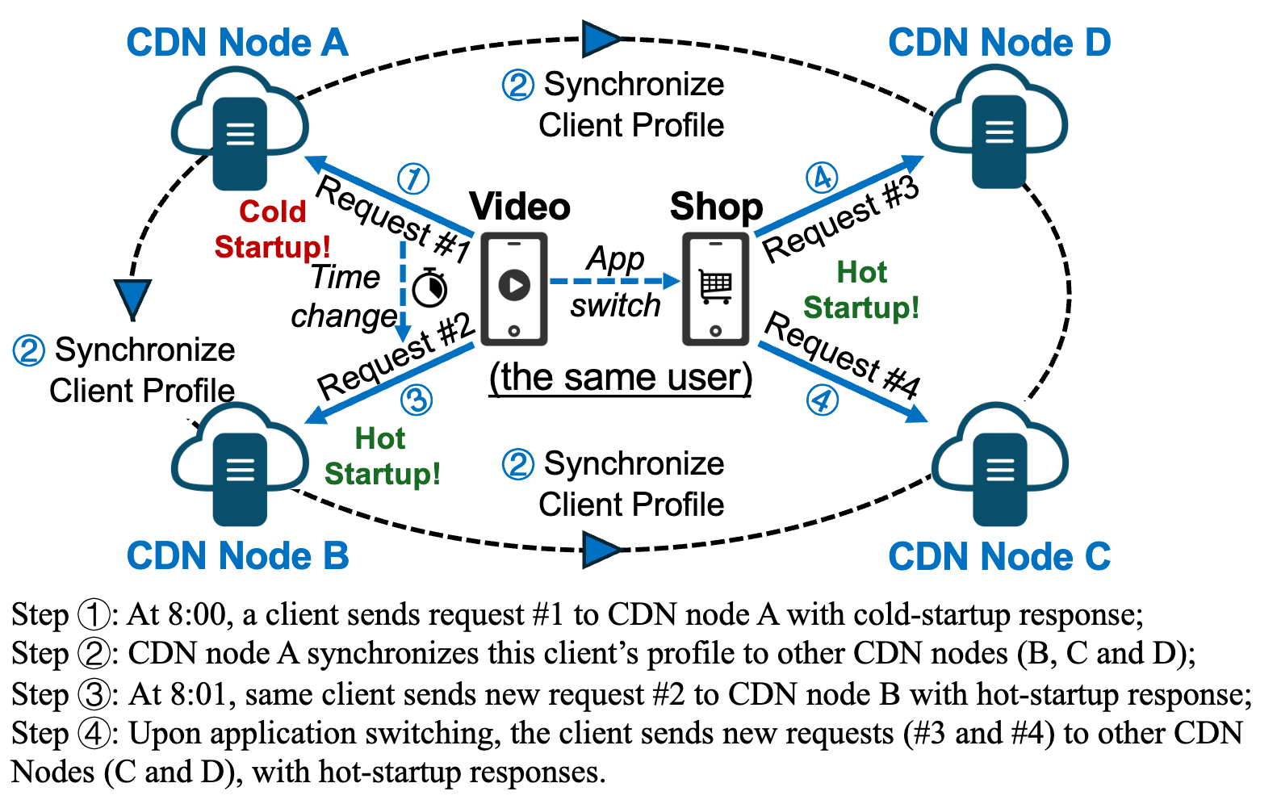
OUR APPROACH
hStart: Multi-CDN as a collective service
Reuse historical network state across CDN nodes—
but validate it before becoming aggressive.
NODE A
HASS
Probe once
→
Share selectively
RTT · bandwidth · cwnd
Space · Object · Time
→
NODE B
APFA
Hot start
→
Predict & validate
Fallback when needed
Trust · freshness · 1st RTT
Notes:
[English Speaker Notes]
The left side of the figure summarizes the hStart architecture. Node A probes the path once and learns RTT, bandwidth, and congestion state. HASS shares only selected high-value profile state, and APFA predicts and validates the startup parameters before Node B performs a hot start. The detailed workflow on the right follows the same user across four CDN nodes. Request number one reaches Node A and experiences a cold start; the client profile is then synchronized. Request number two reaches Node B and can hot-start. After an application switch or a later request, Nodes C and D can reuse the profile in the same way. If validation detects changed conditions, hStart falls back immediately.

Slide 6
MECHANISM 1 · SYNCHRONIZATION
HASS: Synchronize Only High-Value State
HASS avoids omniscient consistency. It filters synchronization along three dimensions.
01 · SPACE
02 · OBJECT
03 · TIME
Where?
Whose?
When?
Group nodes by geography and network topology.
Keep hotspot and high-priority traffic.
Trigger only meaningful updates.
Use an online Space-Saving hot-domain list; skip low-value long-tail state.
Synchronize only when standardized state distance exceeds a threshold.
Replace global O(N²) full mesh with logical sync groups based on location and AS/IDC information.
Result: high-value client profiles only.
Notes:
[English Speaker Notes]
The first mechanism is HASS, which avoids expensive global consistency. A full-mesh design has quadratic communication cost, so HASS filters synchronization in three dimensions. Space groups nearby or topologically related nodes. Object keeps hotspot domains and high-priority traffic while dropping long-tail state. Time triggers an update only when the new sample differs enough from the stored history. The goal is not to synchronize everything; it is to make high-value client profiles available where they are most likely to help.

Slide 7
MECHANISM 2 · TRANSPORT
APFA — history is advice, not orders
Predict, Validate, and Fall Back.
PREDICTIVE INITIALIZATION
FIRST-RTT VALIDATION
Confidence combines long-term Trust T with information freshness Δt.
Pace the predicted window
↓
Observe ACKs, RTT, and loss
Validate (1st RTT)
↓
↓
RTT inflation or any packet loss?
OK → accelerate
Fail → fallback
Fresh + stable history moves the start toward the historical window.
Stale + volatile history moves it back toward the safe default.
↓
update trust T
(closed loop)
Notes:
[English Speaker Notes]
The second mechanism is APFA. Its confidence is alpha of t, equal to the long-term Trust score multiplied by an exponential freshness decay. The initial congestion window is a mix of between the historical window and the safe default window. A fresh and stable history gives a more aggressive start; a stale or volatile history naturally returns toward the default. APFA then paces the predicted window during the first RTT and observes ACKs, RTT inflation, and packet loss. A failure triggers immediate fallback; a successful validation enters congestion avoidance. The final outcome updates Trust, closing the loop for future requests.

Slide 8
EVALUATION · SIMULATION
Faster and safer at the same time
Setup: Mahimahi testbed, 3 net profiles (stable-high-BW, mobile-weak, high-loss).
Baselines: BBR10/32/64/100, Cubic10, hStart_{woa} / hStart_{wa}.
Test server1
Collaborative sharing
Simulator
Test server2
Client
Test server3
Server-side QUIC implementation. No client modification required.
−35%
−34%
At 8 Mbps
18% → 11%
Median FCT vs. BBR10
P95 FCT vs. BBR10
packet loss: BBR100 to hStart
Notes:
[English Speaker Notes]
The entire design is implemented on the QUIC server side and requires no client modification. We evaluate hStart in a Mahimahi testbed with three typical
network profiles and compare it with multiple BBR initial windows, Cubic, and hStart ablations. Relative to BBR10, hStart reduces median flow completion time by thirty-five percent and the ninety-fifth percentile by thirty-four percent. More importantly, it avoids the cost of blindly using a large initial window. At eight megabits per second, BBR100 produces an eighteen-percent loss rate, while hStart reduces it to eleven percent through validation and fallback.

Slide 9
EVALUATION · REAL-WORLD A/B TEST
Faster and safer at the same time
Production: >30M short-video streams, 3 provinces in China, 50/50 A/B, 7 days
FIRST-FLOW THROUGHPUT
+19.15%
+46.47%
Overall throughput · 21.20 → 25.27 Mbps
−21.43%
Relative rebuffering reduction · 0.14% → 0.11%
16.70 → 24.46 Mbps
+4.03%
The largest gain appears exactly where hStart is designed to help: the first flow of a new connection.
Average video bitrate · 794 → 826 Kbps
+30.77%
Requested video chunks per user · 3.25 → 4.25
Notes:
[English Speaker Notes]
We also ran a seven-day, fifty-fifty production A/B test across more than thirty million short-video streams in three provinces in China. The largest gain appears exactly at our target: first-flow throughput increases by 46.47 (forty-six point four seven) percent. Overall throughput improves by 19.15 (nineteen point one five) percent. At the application layer, average video bitrate increases by 4.03 (four point zero three) percent, requested chunks per user increase by 30.77 (thirty point seven seven) percent, and the rebuffering ratio decreases from 0.14 (zero point one four) to 0.11 (zero point one one) percent, a relative reduction of 21.43 (twenty-one point four three) percent.

Slide 10
COST
Deployment Cost Is Small and Bounded
OVERHEAD
SYNCHRONIZATION TRAFFIC
AVERAGE QUERY LATENCY
STORAGE USAGE
5 ms
300 MB
<0.8%
CPU USAGE
24-HOUR QUERY HIT RATE
of total traffic under HASS’s hierarchical, on-demand strategy
3%
71.34%
EVALUATED SCALE
HOT-USER STATE HIT RATE
Most high-value connections can reuse historical information without a global broadcast.
10,000
75–85%
state updates / second
Notes:
[English Speaker Notes]
Finally, the synchronization cost remains bounded at edge scale. We evaluate update rates up to ten thousand states per second, while synchronization traffic stays below 0.8 (zero point eight) percent. The average profile-query latency is five milliseconds, with about three hundred megabytes of storage and three percent CPU usage. After twenty-four hours, the overall query hit rate reaches 71.34 (seventy-one point three four) percent, and the hit rate for hot-user states remains between seventy-five and eighty-five percent. These results show that selective synchronization is practical rather than merely conceptual.

Slide 11

TAKEAWAYS
From isolated CDN nodes to
collective transport intelligence.
Reuse. Share previously probed RTT, bandwidth, and congestion state across CDN nodes.
Control. HASS bounds synchronization cost; APFA bounds stale-state risk.
Result. +46.47% first-flow throughput and −21.43% relative rebuffering.
Impact. First collaborative hot-start CC across CDN nodes at scale.
Future work
­➔ Larger geographic & topological scale across global ISPs.
­➔ Benchmark vs SOTA transport-init & parameter-caching schemes.
……
Thank you
Questions welcome
Tencent EdgeOne: edgeone.ai
Research group: litonglab.com
Email: jiuxiangzhu@tencent.com
Notes:
[English Speaker Notes]
To conclude, hStart contributes three main ideas. First, it reuses network knowledge across CDN nodes instead of repeatedly starting from zero. Second, HASS controls synchronization cost, while APFA controls the risk of stale information. Third, the design delivers measurable production impact, including a 46.47 (forty-six point four seven)-percent gain in first-flow throughput and a 21.43 (twenty-one point four three)-percent relative reduction in rebuffering. Our next steps are broader deployment across regions and ISPs, and comparison with more state-of-the-art startup and parameter-caching schemes.
Finally, the contact information is shown at the bottom right. You can send email, visit our research group homepage, and learn more about Tencent EdgeOne.
Thank you for your attention, and welcome your questions.

